Slide 1
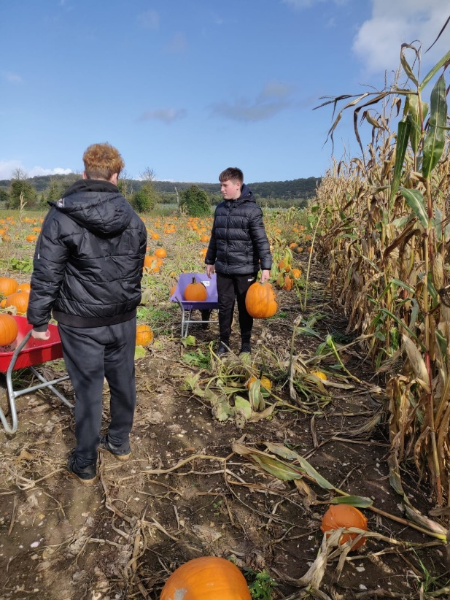
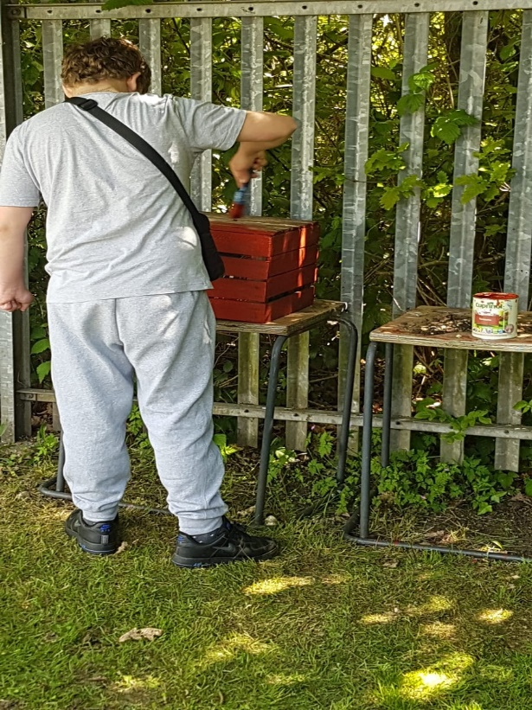
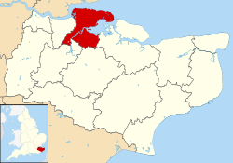
LMI AND LOCAL JOB OPPORTUNITIES IN MEDWAY AND MAIDSTONE

Slide 2

LMI and local job opportunities
Learning Objectives :
To explore the concept of the labour market and its relationship to local employment opportunities.
To create an awareness of the skills required by employers.
To identify own soft skills.
Learn how to work in a group.
To explore what subjects you are interested in and how are these related to a job/employment sector.

Slide 3



Buzz Quiz - self-discovery and reflection
Click here Buzz Quiz to complete the quiz
https://icould.com/buzz-quiz/?buzz_page=0
This will help you focus on possible career
Get to know yourself better ( self-awareness)
Identify your strengths and preferences
Links your personality to how you like to work ( in an office or outside) and types of jobs

Slide 4


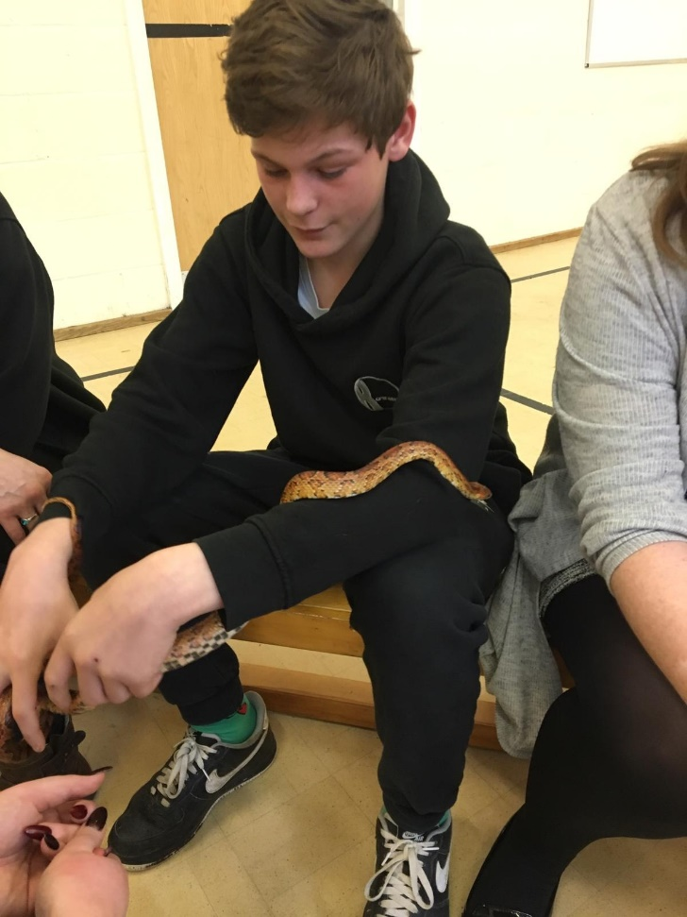
Make a note of your results
Student Name………………………………………….. Date……………………
Buzz Quiz
What animal personality are you?
What are some of the related qualities?
What are some of the related careers?

Slide 5

Make a note of your type of animal
Do you agree with your results?
What surprised you?
Discuss these results with your teacher, career adviser, parents or carers

Slide 6

JOB SECTORS
There Are Many Career Routes To The Job You Want
Click here to explore your options https://www.youthemployment.org.uk/careers-hub/
Make your own notes : .
Match your result with the different job sectors and make a note of it
Check entry requirements
Watch some of the videos
What skills and qualifications are related to jobs, and possible routes after year 11
What are your post 16 routes options ?
  College
  Sixth Form
  Apprenticeship
  University
  Traineeship/ specialised training provider

Slide 7


Click on this link for information https://www.youthemployment.org.uk/careers-hub/
Find out what skills, qualifications and experience are needed
Tips to be your best when applying for these jobs
Post-school, Apprenticeships & University routes

Slide 8

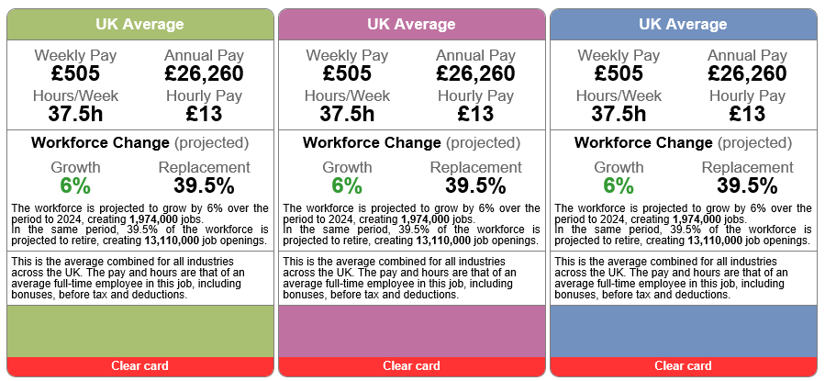
Click here for information on this link
https://www.youthemployment.org.uk/careers-hub/
Look for this image
Find out about salaries for job
What training do you need
Where can you apply.
LMI for All

Slide 9
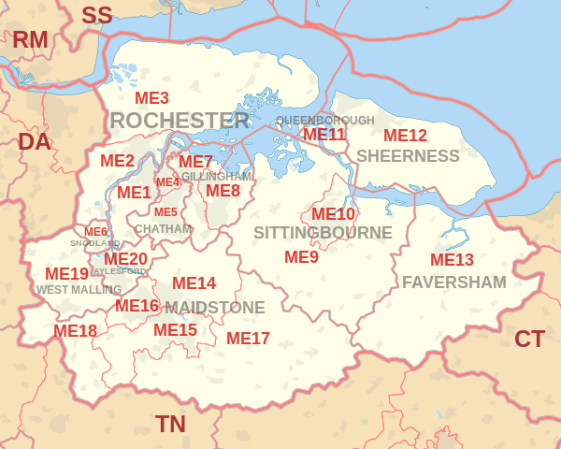

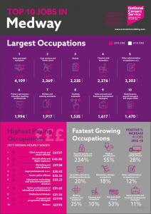
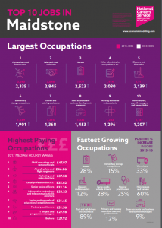


TOP 10 JOBS IN MEDWAY AND MAIDSTONE:
Check your Buzz Quiz
results and compare with
the different jobs in Medway and Maidstone

Slide 10

TOP 10 JOBS IN MEDWAY
AND MAIDSTONE:
Check your Buzz Quiz
results and compare with the different jobs in Medway and Maidstone
What skills and qualifications are related to a job ?
After year 11 what are your options?
What is the salary ?

Slide 11

TOP 10 JOBS IN MEDWAY AND MAIDSTONE:
Check your Buzz Quiz results and compare with the different jobs in Medway and Maidstone
Click here for further information on training, apprenticeships, entry requirements
https://nationalcareers.service.gov.uk/explore-careers

Slide 12
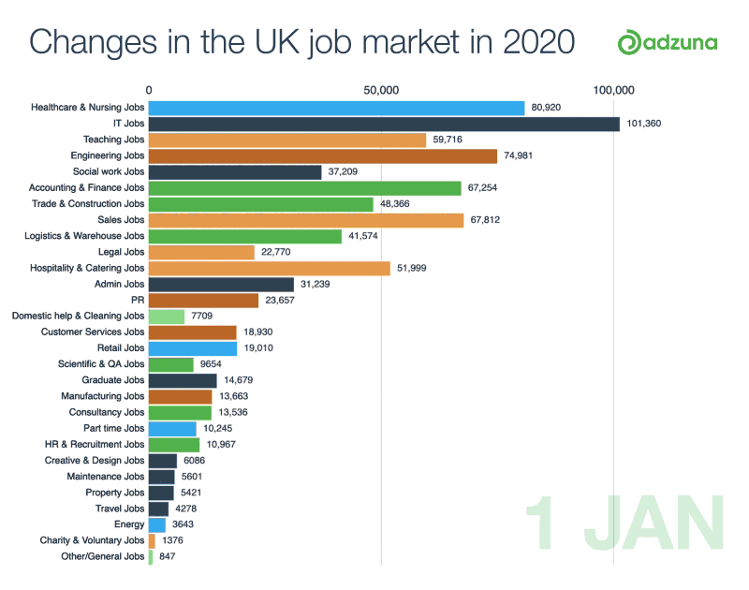
POST SCRIPT: JOB MARKET
AFTER COVID-19
Click for more infographics https://www.facebook.com/adzuna/videos/259754321876875/

Slide 13





https://successatschool.org/advicedetails/1232/crisis-careers-heroes-coronavirus-key-workers

Slide 14

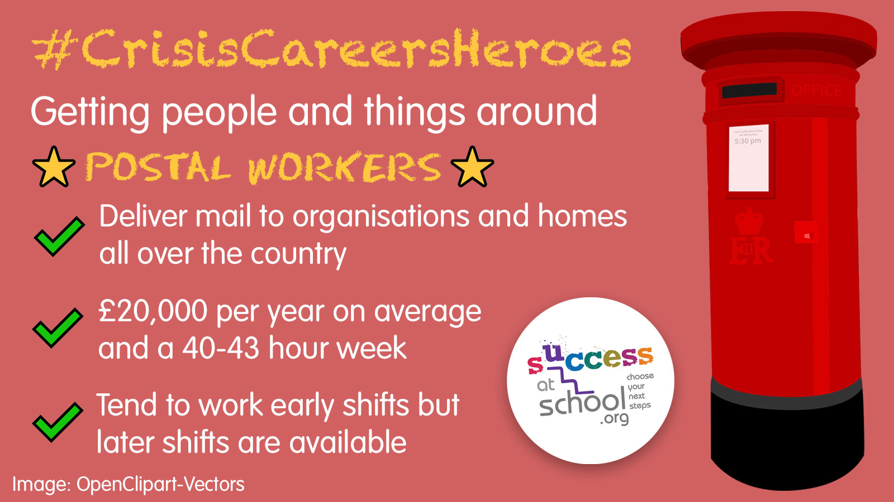


https://successatschool.org/advicedetails/1232/crisis-careers-heroes-coronavirus-key-workers

Slide 15


This workshop meets Gatsby Benchmark #2
Career and labour market information
https://successatschool.org/advicedetails/1232/crisis-careers-heroes-coronavirus-key-workers

