Slide 1
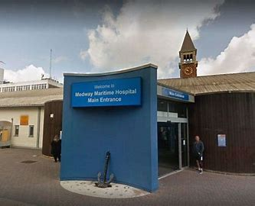
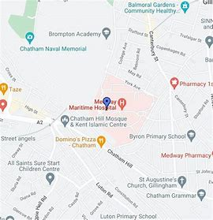
Medway Maritime Hospital
Work for us!

Slide 2
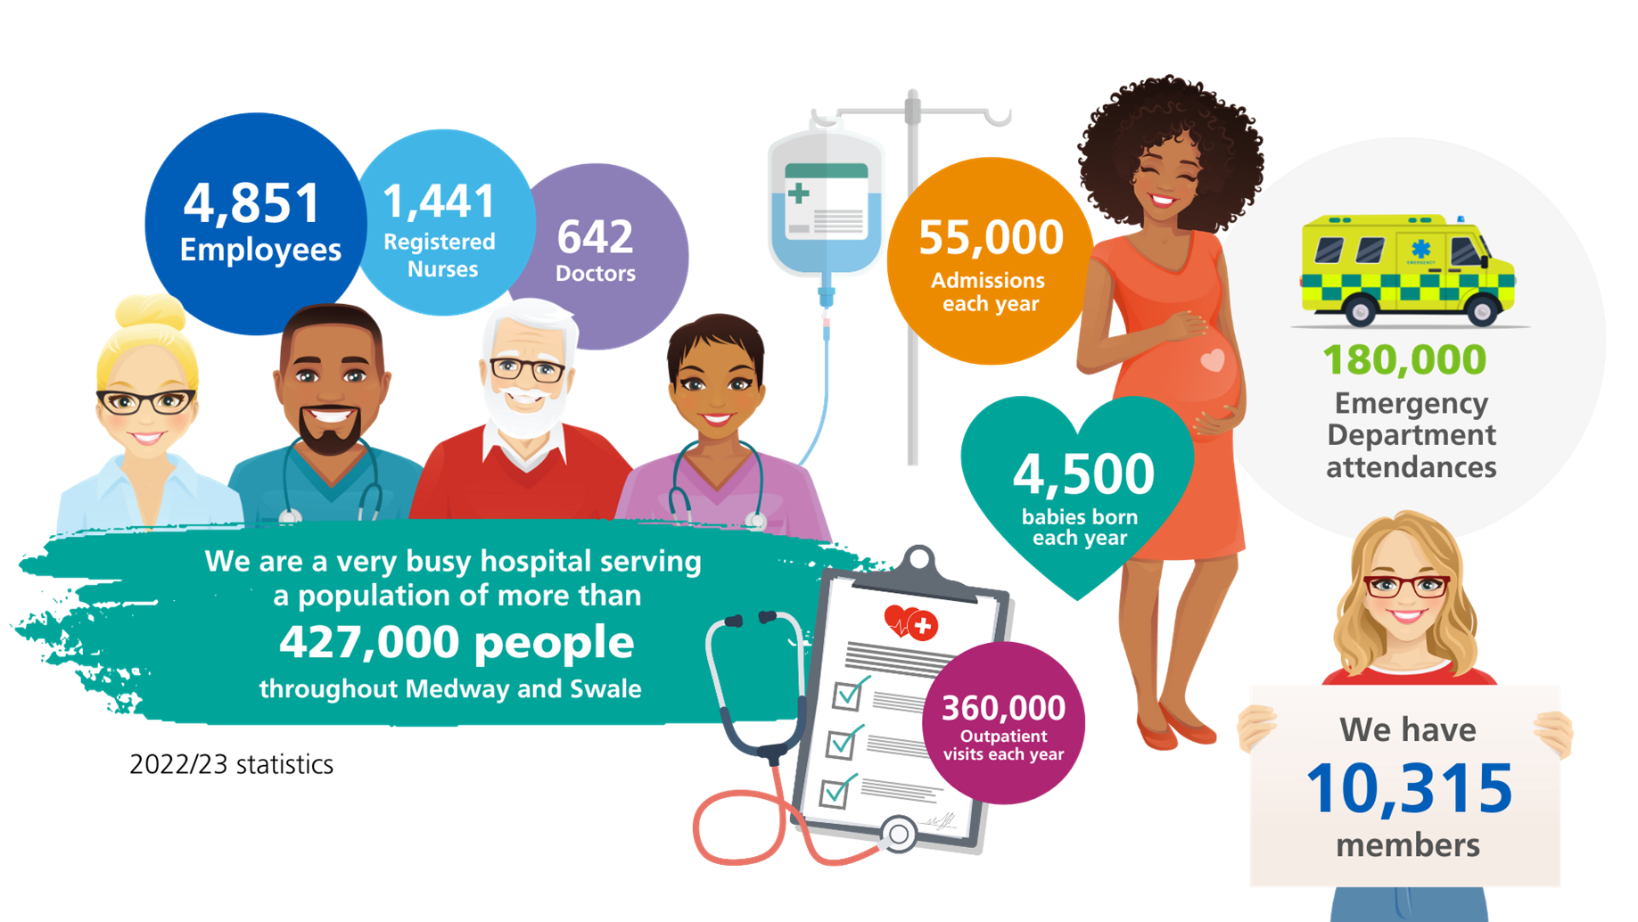
Medway Maritime Hospital

Slide 3
Work Experience Opportunities
Work Experience gives those interested in a career in the NHS the opportunity to experience what happens in hospitals, to observe the day-to-day work of NHS staff and gain an insight into the varied job roles vital to the NHS.
We offer block week work experience in over 20 different areas of the hospital click here for the areas
We offer work experience from 14 years of age
Candidates need to submit an application to express an interest in work experience
Last year we offered 96 students placements at the hospital. We did however have over 200 applications
As soon as the application window opens, please submit your application to avoid disappointment
Application for block week work experience windows open October, January, April and July
Please see our website for the most up to date information here
It will give you an understanding of the attitudes, the behaviours and values that are expected in a healthcare setting.

Slide 4


Other opportunities:
Apprenticeships
We have between 90-140 apprentices at one time
Year on year this is growing and becoming more popular
95% of our apprentices are for current workers
Last year we offered the following apprenticeships to external people:
  Children's practitioner (in our own nursery – Tiny Tugs Day Nursery
  IT
  Audiology and Hearing aids
  Pharmacy
  Current vacancies click here
https://youtu.be/I5KyXKre9So
NHS Apprenticeships - The Hidden Gem

Slide 5

Other opportunities:
Supported Internships
We work in partnership with bemix to offer Supported Internships. For 2024 we have offered the following areas to 6 candidates from bemix:
Catering department
Laundry
Portering
Post room
Applications via bemix directly for candidates with EHCP
Click here for more information

Slide 6

Other opportunities:
In partnership with MidKent College offering:
RCN Nursing Cadets (Observational placements)
T-Level – Health & Science (Industry placements)
We offer the placements to some students from MidKent college to support their career development as part of their studies.
To explore their offer:
Events | MidKent College
Medway Campus
13th March 2024

Slide 7
What is the new to care program
This is a 2 week induction program , which runs every 3 months , and is for people who have no care experience , but have an ambition to pursue a career in health care .

Slide 8
What is incorporated in the 2 week program
Focus on the foundation skills for the role
The care certificate
Session with specialist teams such as tissue viability , falls , enhanced care
Visit to allocated ward , with associate educator
2 taster early shifts in the 2nd week.
2 weeks supernumery on allocated ward ( this can be extended )
Continuing pastoral support on your ward from the associate educators.

Slide 9
Application process
The advert for the New to care clinical support worker can be found on the NHS jobs website.
If shortlisted, candidate will be invited to an assessment day with the senior practise development nurse and the associate educators.
If candidate is successful , they will be informed on the day and then added to the next available program cohort

Slide 10
Assessment day
Welcome and introduction . The role of a csw explained by associate educator
Teaching a practical skill and assessment
Short 1-1 interview
There will be opportunities throughout the assessment to ask questions

Slide 11
What we look for
The assessment day is your interview. However we cannot base our selections on knowledge and experience , so we are looking at the following during assessment.
Personality – how did you interact with others, where you chatty , did you ask questions, did you show an interest
How did you match our trust values . Bold , Every person counts, Sharing and open, Together
Listening skills during practical skill teaching. Did you talk to your partner, did you complete the task as explained

Slide 12
What we look for –continued
We place value on, persons personality , passion and life experiences , when making our selections for the program.
If you are not suitable yet for the role , we can support and point you in the right direction , to prepare for future applications

Slide 13
Example of week one timetable
Monday | Trust Induction
Tuesday | Trust induction Moving and handling Basic life support
wed | welcome &icebreaker 09.00-10.00 | Introduction to Medway ROLE OF CSW 10.00-11.30 |  |  | Uniform collection 11.30-12.30 | B R E A K |  | Care certificate & portfolio 13.00-13.30 |  | ADL`S 13.30-15.00 | Questions and close 15.00-16.00
Thurs | Register 08.30 | News 2 Theory 08.30-09.30 |  |  | NEWS 2 /OBSERVATIONS PRACTICAL 09.30-12.00 |  |  |  | B R E A K | DIET AND NUTRITION 12.30-13.30 | COMMUNICATION 13.30-15.00 | Q&A 15.00-16.00
FRIDAY | BLOOD COLLECTION TBC |  | B R E A K | ELIMINATION 12.30-13.30 |  |  | WARD VISITS IN UNIFORM 13.30-16.00

Slide 14
On going support
When you have completed your 2 week induction , you will go to your ward on a supernumery basis. This means you will not be added into the staffing numbers for your shift and will be there to continue to learn , shadow your buddie and support the staff.
You will normally stay supernumery for 2 weeks , however this can be extended if you or your ward manager feels you need a little more time to settle on to your ward.
During this time you will have visits from the PDN and Associate educator , for pastoral support . They are also available for you to contact should you need them during this time

Slide 15
CSW duties
Carry out clinical tasks under the supervision of the nurse
Carry out person centred care
Chaperoning patients to their scans
Updating care plans
Escalating concerns
House keeping
Vital sign observations
Carry out ecg
Transfer patients
Stock up ward
Take bloods (when trained and competent)
This list is not exclusive , as you gain knowledge your skill set will increase ,as will your roles and responsibilities

Slide 16
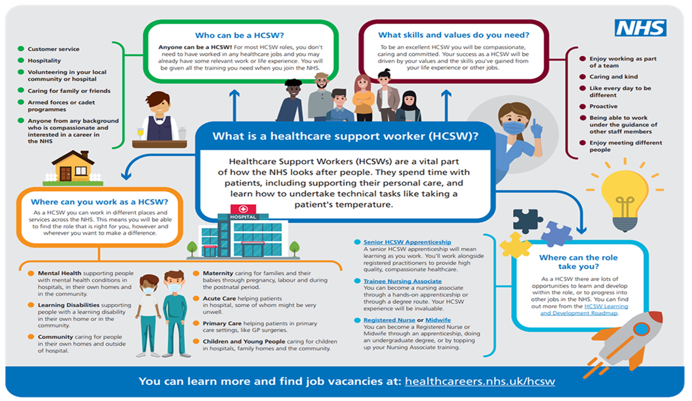

Slide 17
Remember
New to Care, could be the start of an exciting and fulfilling journey.
Where you start, isn’t always where you will finish.

Slide 18
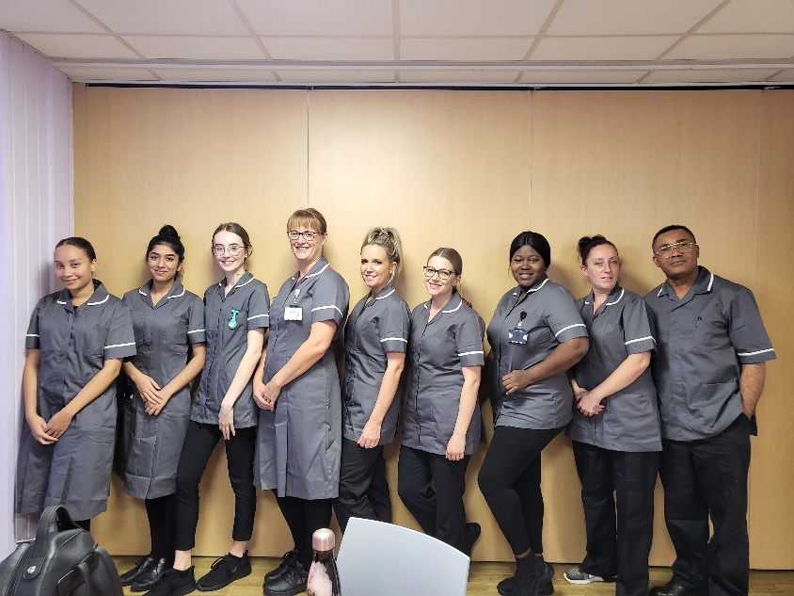
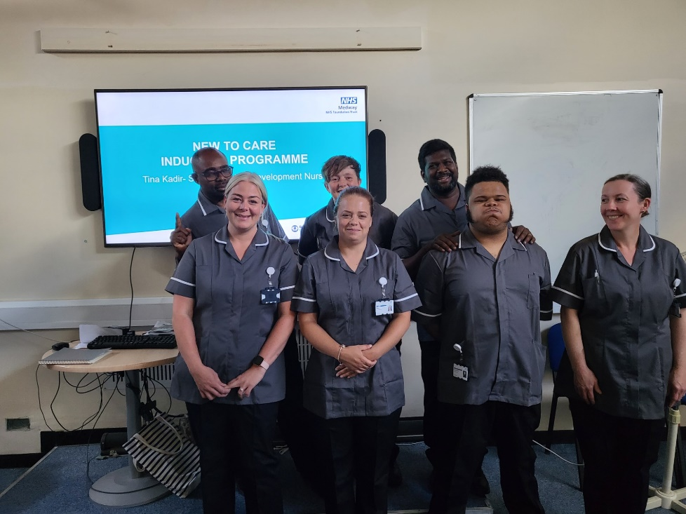
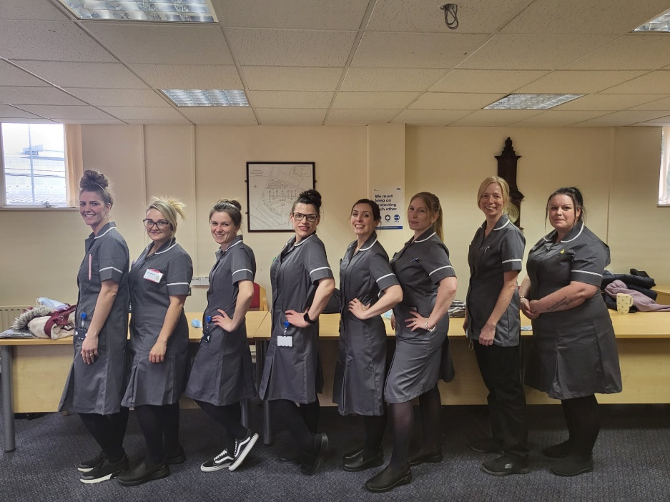
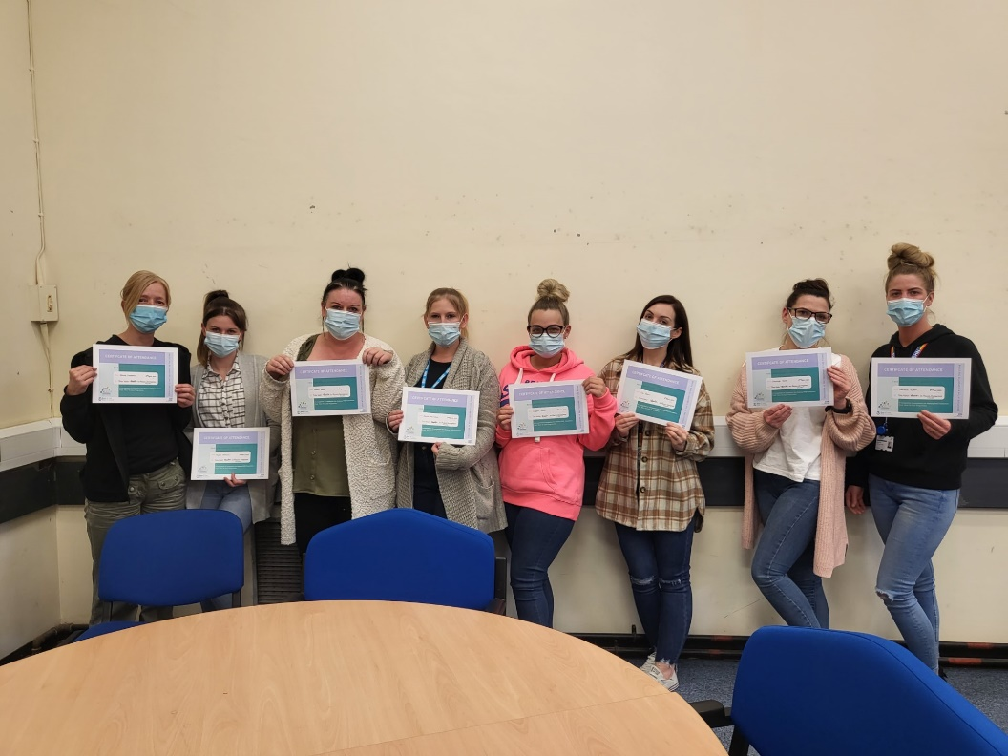
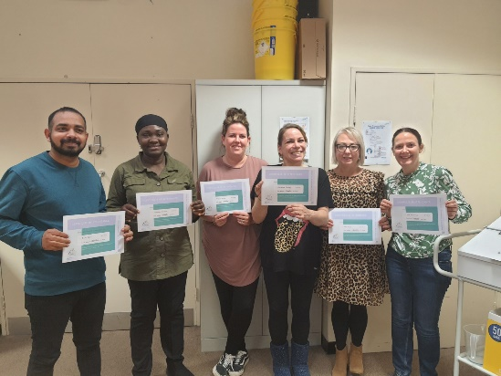

Slide 19

Nursing Associate (NA) programme
A nursing associate (NA) is a new member of the nursing team in England. This role is designed to help bridge the gap between health care assistants and registered nurses (RN) as identified in The Shape of Caring Review (2015).
Nursing associate is a stand-alone role regulated by the NMC, which will also provide a progression route into graduate level nursing.
The programme consists of both academic and work-based learning to develop an understanding and knowledge of person-centred care from birth to end of life. Nursing Associates will work across the different fields (adult, mental health, children and young people and learning disabilities) and in different settings (in hospitals, close to home and at home) across the Trust and other organisations.
What is needed for the role?
GCSE English and Maths, or equivalent (functional skills)
Completion of the Care Certificate

Slide 20

How to become a Registered Nurse?
There are two ways to this:
You can do the Registered Nurse Apprenticeship which would need to be sponsored by the employer which would be 18 months if you have completed the NA course .
Degree route: You will need at least five GCSE’s grade 4 or above in English maths and science and at least two/ three A-levels or equivalent level 3 qualifications.

Slide 21

Where to go once a Registered Nurse?
Progression through the wards with many different specialities e.g. medical, surgical, cardiac and frailty
Specialist: Tissue viability Nurse, Falls specialist Nurse, dementia specialist Nurse, Cardiac Specialist Nurse, Respiratory specialist Nurse, Nursing Workforce

Slide 22

Other Roles
Therapy Assistant
Occupational Therapist
Physiotherapist
Dietician
Speech and Language Therapist
Admin
Security

Slide 23
Any questions

